Slide 1


Slide 2
Memory
Basics & Caching

Slide 3
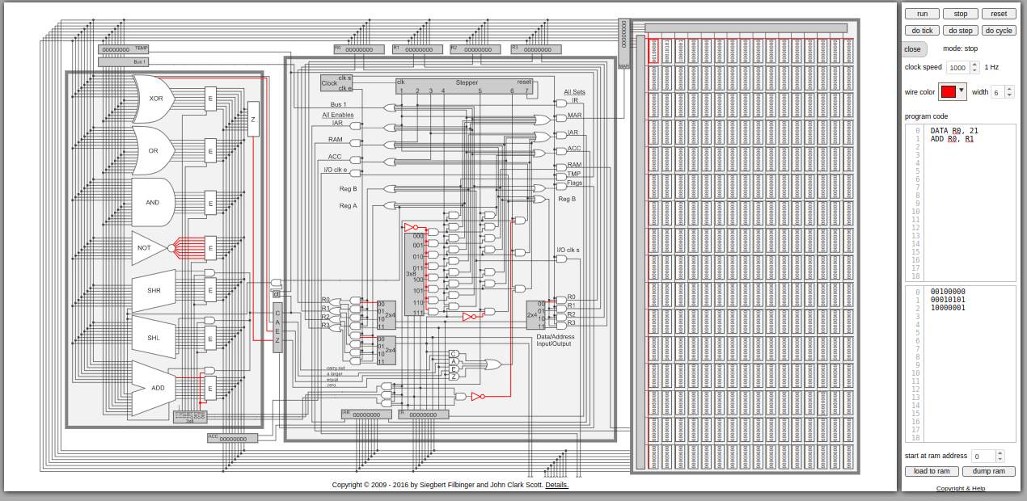
Last Few Lectures
We saw how the control logic of the Scott CPU works
But we glossed over memory
The Memory Address Register (MAR) and all that stuff on the right hand side
Time to take a look at that!
Notes:
Can be found online… but I can’t link to it

Slide 4
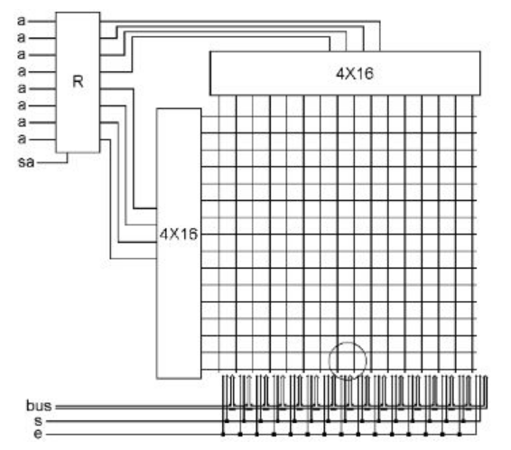
Memory
To understand how memory works we need to again recall the concept of a decoder
A decoder takes n bits and enables 1 of n^2 wires
Here we see two 4x16 decoders, wired into the MARs top 4 and bottom 4 bits
Notes:
Can be found online… but I can’t link to it

Slide 5
Memory
What will this do?
Given an address in MAR, exactly one top wire and one bottom wire will be activated
Where those two wires meet is 8 bits of memory
Notes:
Can be found online… but I can’t link to it

Slide 6
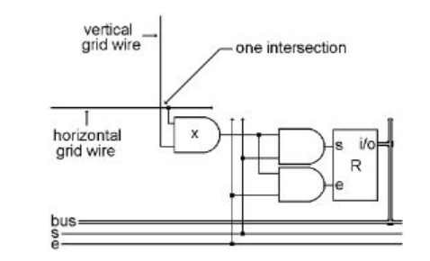
Memory
At the intersection of the wires is an AND gate
If both the vertical AND the horizontal wire are enabled, then this memory location is selected
If, additionally the set wire is enabled, the memory location is written to from the bus
If, alternatively, the enable wire is on, the memory location is put on the bus
Notes:
Can be found online… but I can’t link to it

Slide 7
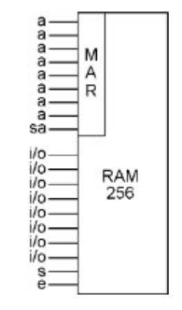
Memory
And that’s it!
The memory chip is much more simple and regular than the CPU chip
Notes:
Can be found online… but I can’t link to it

Slide 8
Memory
Types of Memory
SRAM - Fast, expensive, used primarily in registers, caches
DRAM - Slower, but much less costly, lower power consumption
Flash - Slower still, but stable without power
Notes:
Can be found online… but I can’t link to it

Slide 9
Memory Latency
In the Scott CPU, Memory and Registers had the same access time
This is not realistic
In fact, there are huge differences between various memory locations
Notes:
Can be found online… but I can’t link to it

Slide 10
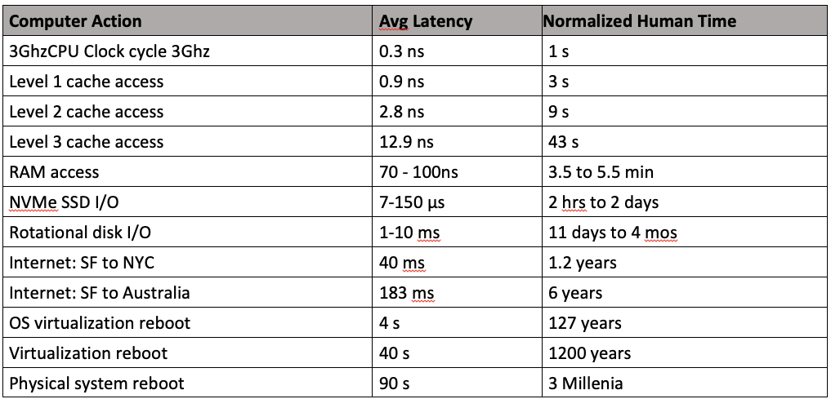
Memory Latency
Registers are typically immediately available to the CPU
RAM is 100x+ slower
Disk is even worse
Network… fuggedaboudit
NB: some folks will freak out about CPU perf in systems that touch the network
lol
Notes:
Can be found online… but I can’t link to it

Slide 11
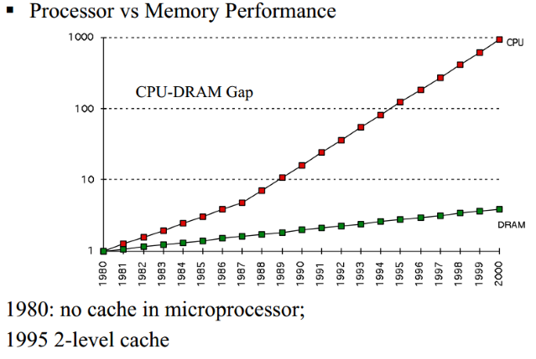
Memory Latency
The difference in speed between the CPU and Memory has grown significantly over time
Consequently, memory access time has become the most significant bottleneck for CPU performance in most workloads
Notes:
Can be found online… but I can’t link to it

Slide 12
Memory Latency
Because there is such a huge penalty for accessing RAM, modern computer systems have introduced caches
Caches store data in faster, intermediate memory, allowing the CPU to access memory more quickly
Notes:
Can be found online… but I can’t link to it

Slide 13
Caching
Note that there are different levels of cache
Level 1 - very fast (almost as fast as registers) and very expensive
Level 2 - larger, slower, less expensive
Level 3 - even larger, slower still, less expensive than level 2
Notes:
Can be found online… but I can’t link to it

Slide 14
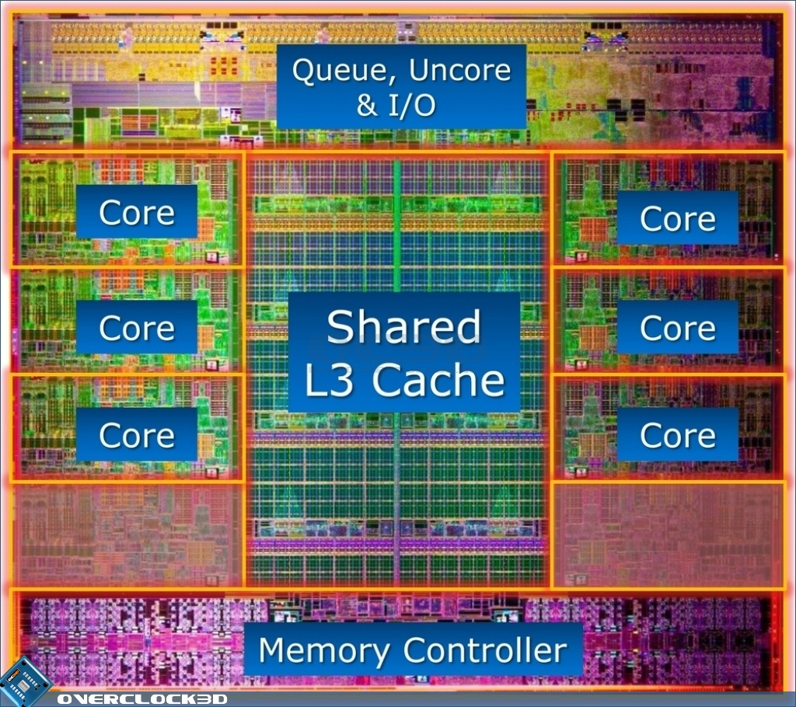
Caching
On a modern multi-core CPU, each core has its own L1 and L2 cache
There is a shared L3 cache
Note that a significant share of the CPU is dedicated to cache
Caching is crucial to modern CPU performance
Notes:
Can be found online… but I can’t link to it

Slide 15
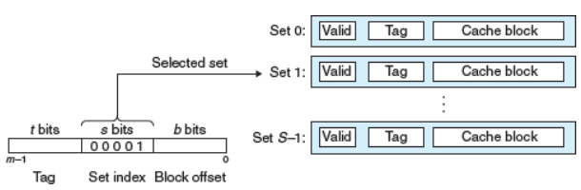
Caching
All caches broadly are implemented the same way
There is a set of memory blocks (not a single address, a block of memory)
The memory blocks have a valid indicator
There is some mechanism for mapping a particular memory address into the cache
Notes:
Can be found online… but I can’t link to it

Slide 16
Caching
Broadly there are three strategies for mapping a memory address into a cache
Direct mapping
Associative mapping
Set associative mapping
Notes:
Can be found online… but I can’t link to it

Slide 17
Caching
Direct Mapping
Consider the memory address 0110 0000 1100
Take some set of bits and map them directly to a slot in the cache
We look at a middle five bits (bits 4-8) to determine which cache slot to look in
Because the value is 0000 1 for this memory address, we look at cache entry 1
Notes:
Can be found online… but I can’t link to it

Slide 18
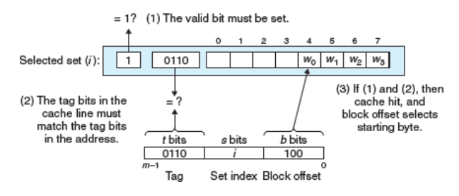
Caching
Direct Mapping
Of course many different addresses could have the bits 0001 in it, so we need to ensure that the cached value is indeed for
This is what the tag bits are for: they are stored in the cache and compared after the look up to ensure that they equal our top four bits
Notes:
Can be found online… but I can’t link to it

Slide 19
Caching
Direct Mapping
Assuming that the tag bits match, we have a hit
We can now index into the cache block by the lower 3 bits to get the cached value at that memory location
In this case, 100 binary means slot 4 of 8
Notes:
Can be found online… but I can’t link to it

Slide 20
Caching
Direct Mapping
Not to complicated
But why are we storing a block of memory? Why not store just an individual piece of memory?
And why did we use the middle bits for the set selection, rather than, say, the high bits?
Notes:
Can be found online… but I can’t link to it

Slide 21
Caching
To answer this question you must recognize that computer programs tend to demonstrate Locality of Reference
If I ask for memory location N, it is very likely that I will soon ask for location N+1
Notes:
Can be found online… but I can’t link to it

Slide 22
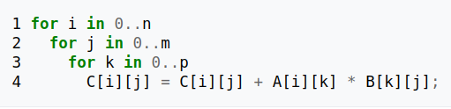
Caching
Here is some pseudocode for matrix multiplication
Note that the arrays are being accessed over and over in locations very close (or identical) to the previous iteration
This algorithm demonstrates a lot of locality
Notes:
Can be found online… but I can’t link to it

Slide 23
Caching
To return to our cache implementation
You can see how having a block of data makes sense in this algorithm
But what about the selection of the set bits? Why the middle? Why not the high bits?
Notes:
Can be found online… but I can’t link to it

Slide 24
Caching
Well, consider an array that would span multiple blocks
Would the high bits of two blocks of memory next to each other be different?
No!
So they would map to the same cache line
Bad! They would conflict with one another
This is why we use the lower bits for set selection
Notes:
Can be found online… but I can’t link to it

Slide 25
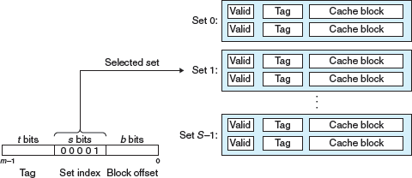
Caching
Set Associative
A more advanced algorithm for caches is a Set Associative cache
The principles are essentially the same, but rather than one cache entry in a given set you can now have multiple cache entries
Rather than comparing a single tag, each tag is scanned for a match
Notes:
Can be found online… but I can’t link to it

Slide 26
Caching
Set Associative
More complex logic in your cache
Potentially better caching behavior
Notes:
Can be found online… but I can’t link to it

Slide 27
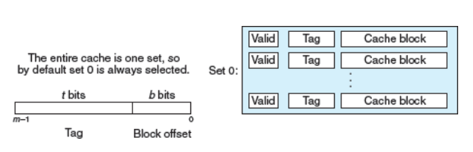
Caching
Fully Associative
Even more advanced (from an engineering standpoint) is a fully associative cache
There is no set selection stage
Simply scan the entire cache for a matching tag
Maximizes your cache utilization regardless of workload
Difficult to make both large and fast
Notes:
Can be found online… but I can’t link to it

Slide 28
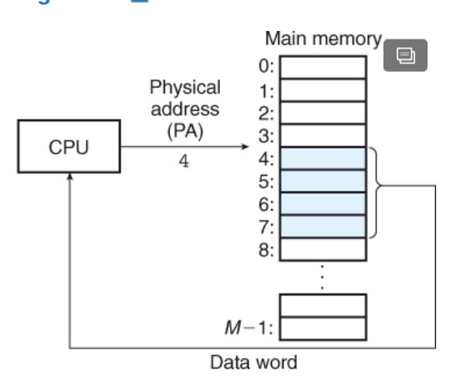
Virtual Memory
The last topic we will briefly cover is Virtual Memory
Broadly, the computer treats memory as a contiguous array of bytes
These bytes may be physically addressed
Notes:
Can be found online… but I can’t link to it

Slide 29
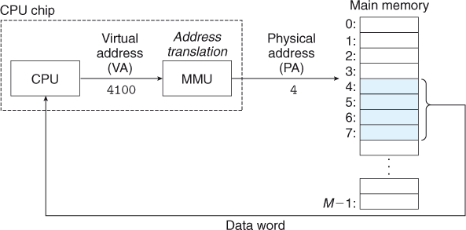
Virtual Memory
Physical addressing can lead to many issues
Collisions between programs
Security issues
Etc.
To address this, the notion of virtual memory was introduced
Notes:
Can be found online… but I can’t link to it

Slide 30
Virtual Memory
All addressed go through a translation step
This allows all processes to see a uniform address space
The Operating System is in charge of ensuring that the proper translation tables are maintained for processes
Notes:
Can be found online… but I can’t link to it

Slide 31
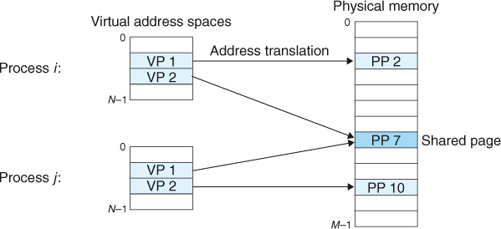
Virtual Memory
Note that two processes, via virtual memory, can share the same physical page
If the page is read only (e.g. a DLL)
If the page is read/write but has not yet been written to
Only after write do the processes need separate pages
Notes:
Can be found online… but I can’t link to it

Slide 32
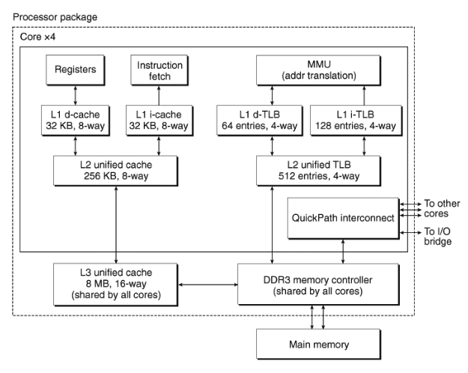
Virtual Memory
Here is the Core i7 memory schema
Note separate data and instruction L1 caches
Harvard Model?
Unified L2 cache
Huge L3 cache (shared)
MMU to do address translation for Virtual Memory
Has its own set of caches
Memory controller connected to RAM
Notes:
Can be found online… but I can’t link to it

Slide 33
Memory
The memory systems are much more regular, in theory, than the controller and ALU components of a CPU
However, because memory latency is a large issue in modern CPU performance, increasing amounts of CPU engineering has gone into efficient memory usage
Caches in particular
Virtual Memory is a feature of modern processors that, in concert with the OS, provides a safe and consistent view of memory for processes

